Slide 1

Fake face DETECTION
GUIDED BY,
Mr.C.MURALE,
ASSISTANT PROFESSOR,
DEPARTMENT OF INFORMATION TECHNOLOGY,
COIMBATORE INSTITUTE OF TECHNOLOGY.
PRESENTED BY,
SRINIVAS.R (1907049)
GOKUL.V (1907010)
KALKIDAS.K (1907018)

Slide 2
introduction
In this technological era a lot of people use technology to manipulate images and use it as evidences to mislead the court.
Social media is a great platform to socialize,share and spread knowledge but if caution is not exercised, it can mislead people.
Current forensic techniques require an expert to analyze the credibility of an image.
We implemented a system that can determine whether an image is fake or not with the help of machine learning and thereby making it available for the common public.

Slide 3
OBJECTIVES
To design a prototype of the system that detects the real and fake face images.
To build the models with the help of ELA and deep neural network architectures.
To utilize the various open source datasets and libraries to build the system.
To identify the fake images to avoid them from wide spreading in social medias.

Slide 4
ABSTRACT
For the detection of forged faces, the first step of the proposed method is image normalization for real and fake image recognition.
This research aims to evaluate the working of different deep learning techniques in the novel "Real and Fake Face detection" dataset.
Normalized images are then preprocessed using Error Level Analysis (ELA) and train to different pre-trained deep learning models.
We finetune these models for categorization of 2 classes that are forged and real to evaluate these models' performance.
The models which we are using to test are:
VGG-16(Visual Geometry Group)

Slide 5
LiTERATURE SURVEY
SI NO | Title | Journal | Year | Author | Methodology | Limitation
1. | Image forgery detection using error level analysis and deep learning | TELKOMNIKA | 2019 | Sudiatmika, I. B. K., & Rahman, F. | ELA and Deep Learning | This model lacks testing accuracy and training accuracy will be 60 – 90%.
2. | Image forgery detection based on Gabor wavelets and local phase quantization | PCS | 2015 | Isaac, M. M., & Wilscy, M. | Gabor wavelets and local phase quantization | High training Cost.

Slide 6
LiTERATURE SURVEY
SI NO | Title | Journal | Year | Author | Methodology | Limitation
3. | Image-splicing forgery detection | EIF | 2015 | Hakimi, F., Zanjan, I., & Hariri, I. | Improved lbp and k-nearest neighbors algorithm | This model is only limited to image tampering detection.
4. | Casia image tampering detection | IEEE | 2013 | Dong, J., Wang, W., & Tan, T. | Evaluating database | This paper was not detection method.
5. | Passive detection of doctored JPEG image | SP | 2009 | Li, W., Yuan, Y., & Yu, N. | Block artifact grid extraction | This model detects only JPEG type.So it can’t detect PNG and other types.

Slide 7
LiTERATURE SURVEY
SI NO | Title | Journal | Year | Author | Methodology | Limitation
6. | Fake Image Detection Using Machine Learning | IJCSITS | 2017 | Villan, Muhammed Afsal, et al | ELA and ML | From this model we only obtain 60% of accuracy.
7. | Deep Fake Image Detection Based on Pairwise Learning | AS | 2020 | Hsu, Chih-Chung, Yi-Xiu Zhuang, and Chia-Yen Lee. | Pairwise Learning | This model not able to detect PGGAN generated 64×64pixels image.
8. | Two Fold Image Forgery Detection System | JICTRA | 2018 | Akhtar, F., & Qayyum, H. | Combined Key point based method and Block based method. | This model detect based on distance between points.It lacks test accuracy.

Slide 8
LiTERATURE SURVEY
SI NO | Title | Journal | Year | Author | Methodology | Limitation
9. | Fake Image Detection Using Machine Learning. | IRACST | 2015 | Villan, M. A., Kuruvilla, A., Paul, J., & Elias, E. P. | Machine Learning | Its testing and training accuracy is comparatively low.
10. | A Study on Digital Image Forgery Detection. | IJARCSSE | 2014 | Sarma, B., & Nandi, G. | Detecting tampering and image composition | This is a study of image forgery and not a detecting model.
11. | Facing off fake images using fake detection fine-tuning network. | Springer | 2020 | Jeon, Hyeonseong, Youngoh Bang, and Simon S. Woo | Fine tuning network | This method does not detect smaller Resolution images.

Slide 9
LiTERATURE SURVEY
SI NO | Title | Journal | Year | Author | Methodology | Limitation
12. | Image inconsistency detection using local binary pattern | PCS | 2017 | Mahale, V. H., Ali, M. M., Yannawar, P. L., & Gaikwad, A. T. | Local binary pattern (LBP) | This model only limited to detect inconsistency of an image.
13.. | Copy-move image forgery detection | Aasri Procedia | 2014 | Hashmi, M. F., Anand, V., & Keskar, A. G. | Robust method combining undecimated wavelet transform and scale invariant feature transform | Wavelet transform may result in high cost and it is only limited to tampered images.

Slide 10
LiTERATURE SURVEY
SI NO | Title | Journal | Year | Author | Methodology | Limitation
14. | Effective image forgery detection | MTA | 2016 | Hu, W. C., Chen, W. H., Huang, D. Y., & Yang, C. Y. | Image watermarking and alpha mattes | This model compares only hue difference between foreground and background.
15. | Detecting both machine and human created fake face images in the wild. | ACM | 2018 | Tariq, Shahroz, et al. | Neural Networks | This model only trained with GAN created images.

Slide 11
PROPOSED SYSTEM
Our dataset consists of RGB images with an extension of (.jpg) which were classified into real and fake classes.
After preprocessing the images of the whole dataset, it was converted into ELA images.
These images were split up into training and test sets, which were then forwarded to the Deep CNN model to recognize real and fake images.

Slide 12
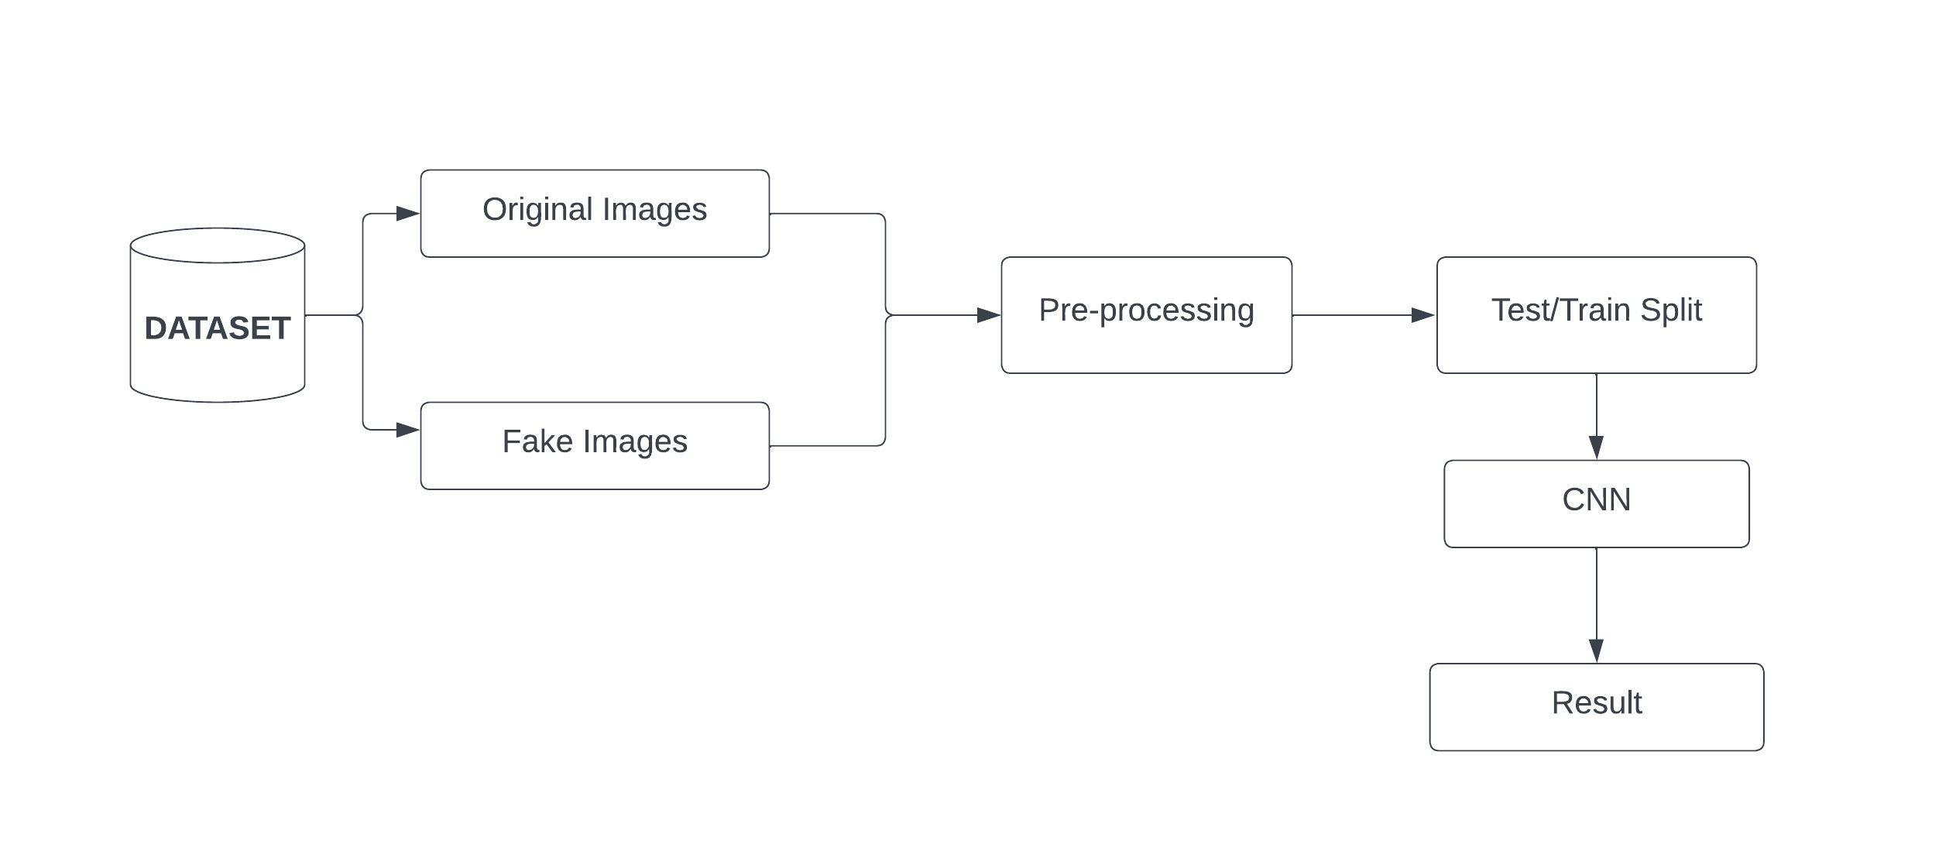
PROPOSED SYSTEM

Slide 13
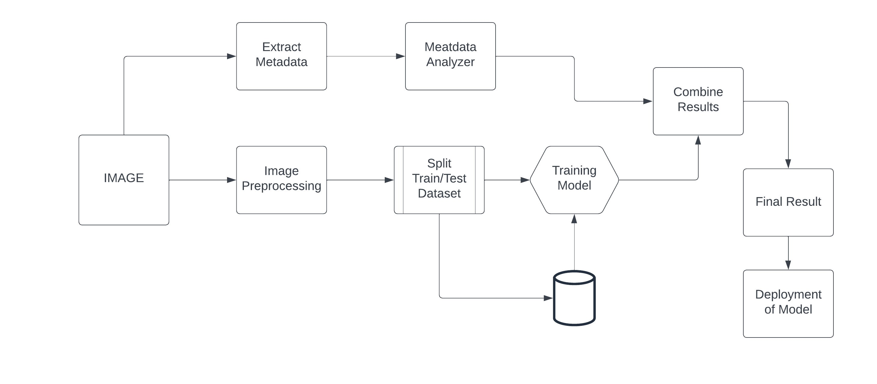
ARCHITECTURE

Slide 14
MODULES
Pre-processing
Metadata Analysis
Image Recognition using Deep Learning
Convolutional neural network
Deployment of Model

Slide 15
PRE PROCESSING
The whole dataset was resized into (128*128) pixels,
Make the whole dataset normalized.

Slide 16
METADATA ANALYSIS
Most image files do not just contain a picture. They also contain information (metadata) about the picture.
Metadata provides information about a picture's pedigree, including the type of camera used, color space information, and application notes.
Metadata provides information related to how the file was generated and handled.

Slide 17
Image Recognition using Deep Learning
All images were saved in NumPy array and split into train set and test set and then the train set was passed to the finetuned pretrained deep learning models.
Pre-trained models were used to evaluate our dataset results:
VGG-16,

Slide 18
CNN NETWORKS
Using Keras libraries, we used the flatten layer and dense layer as a sequential CNN model.
These layers were used to finetune all the deep learning models

Slide 19
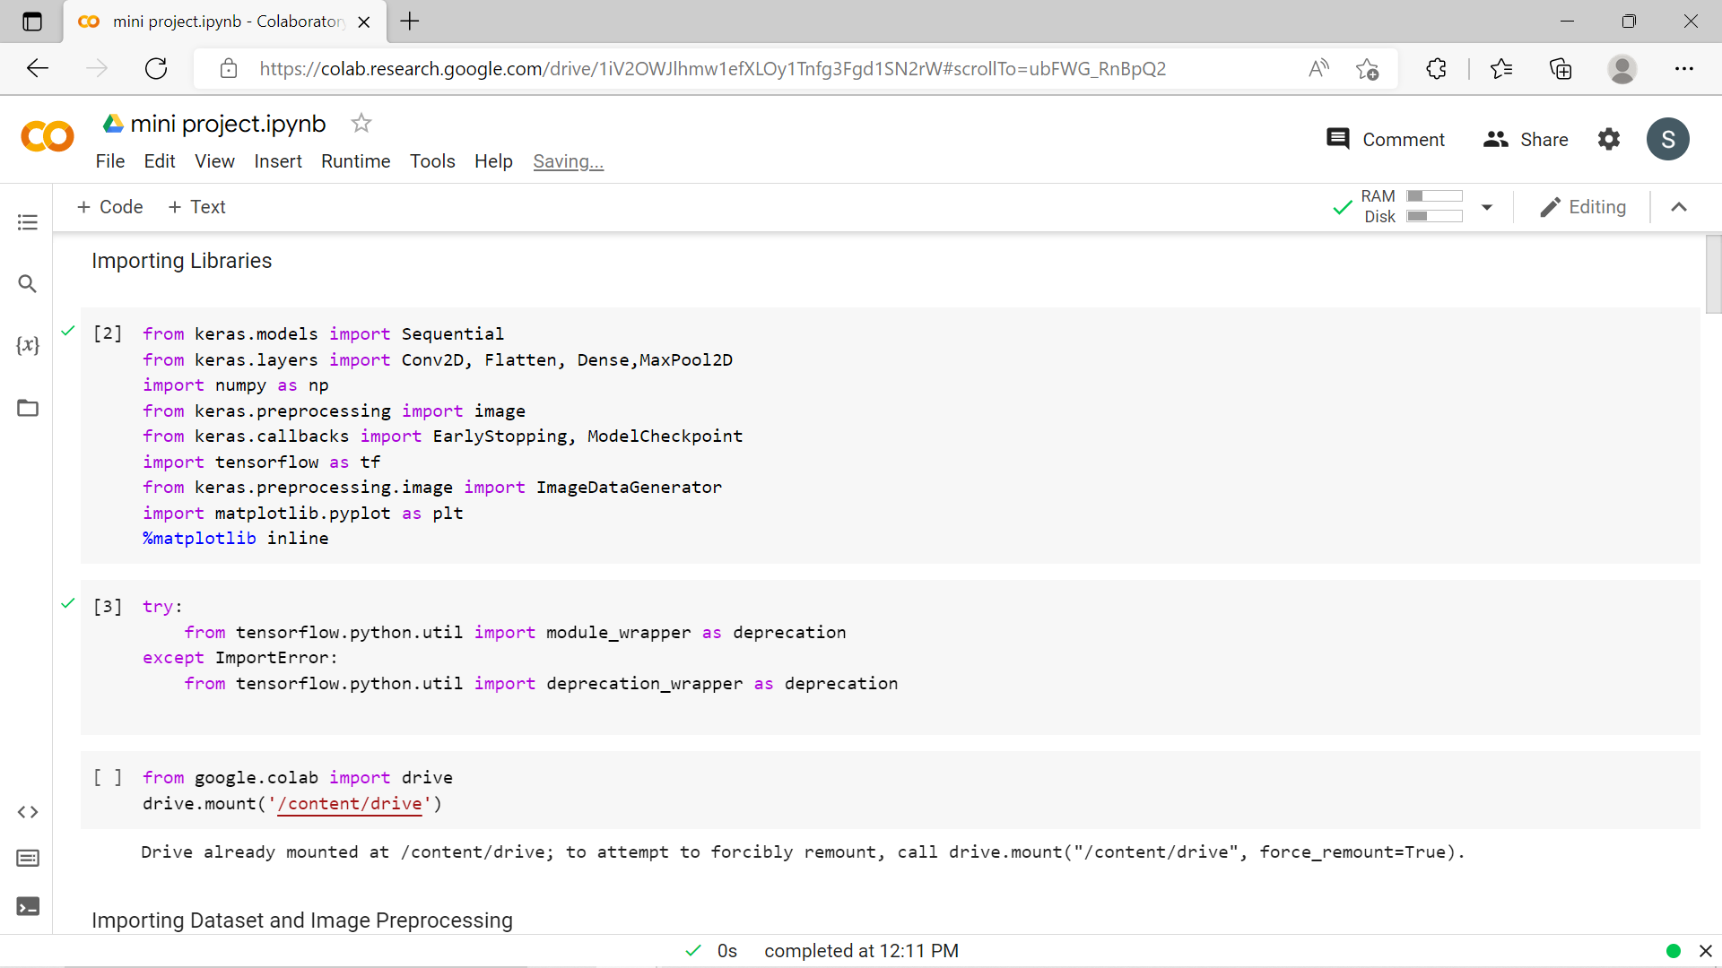
implementation
IMPORTING LIBRARIES

Slide 20
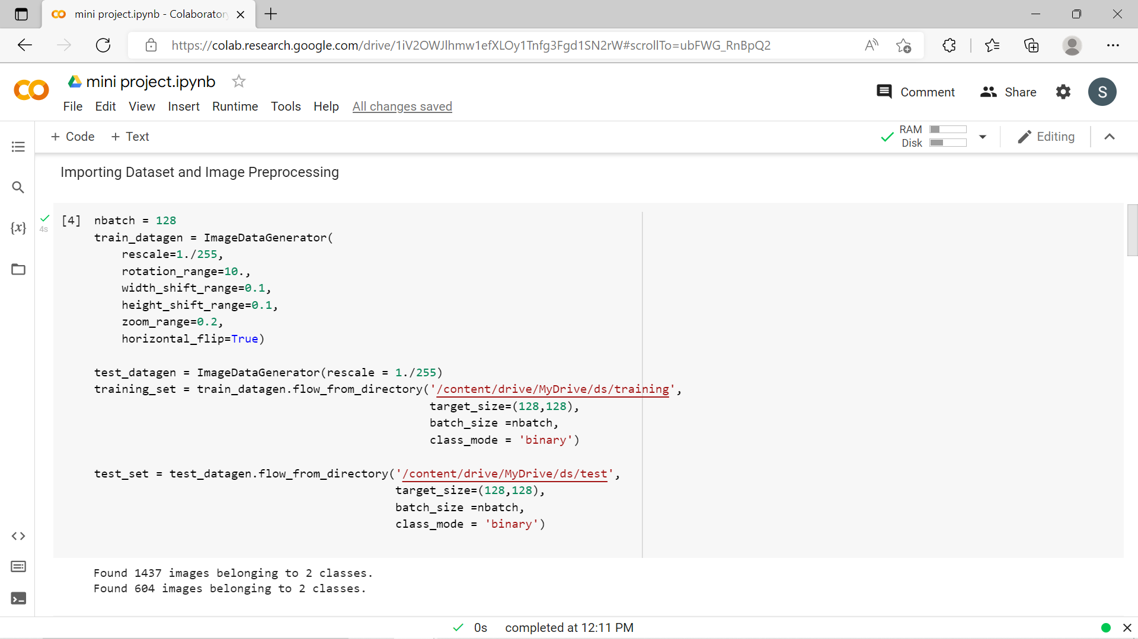
implementation
IMAGE PREPROCESING

Slide 21
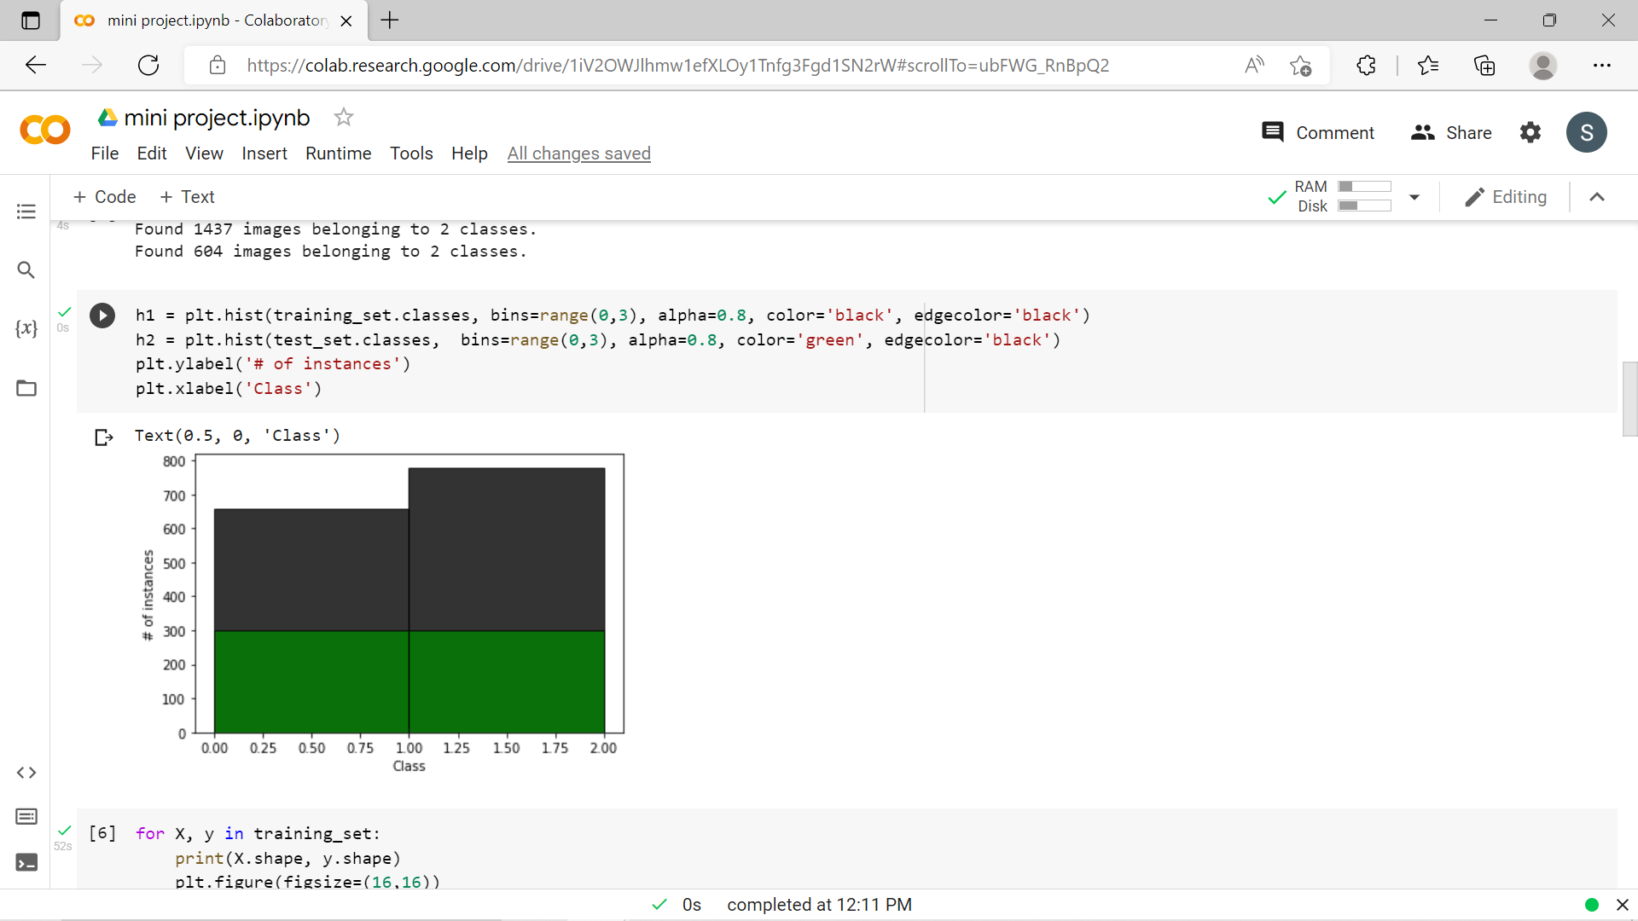
implementation
IMAGE PREPROCESING

Slide 22
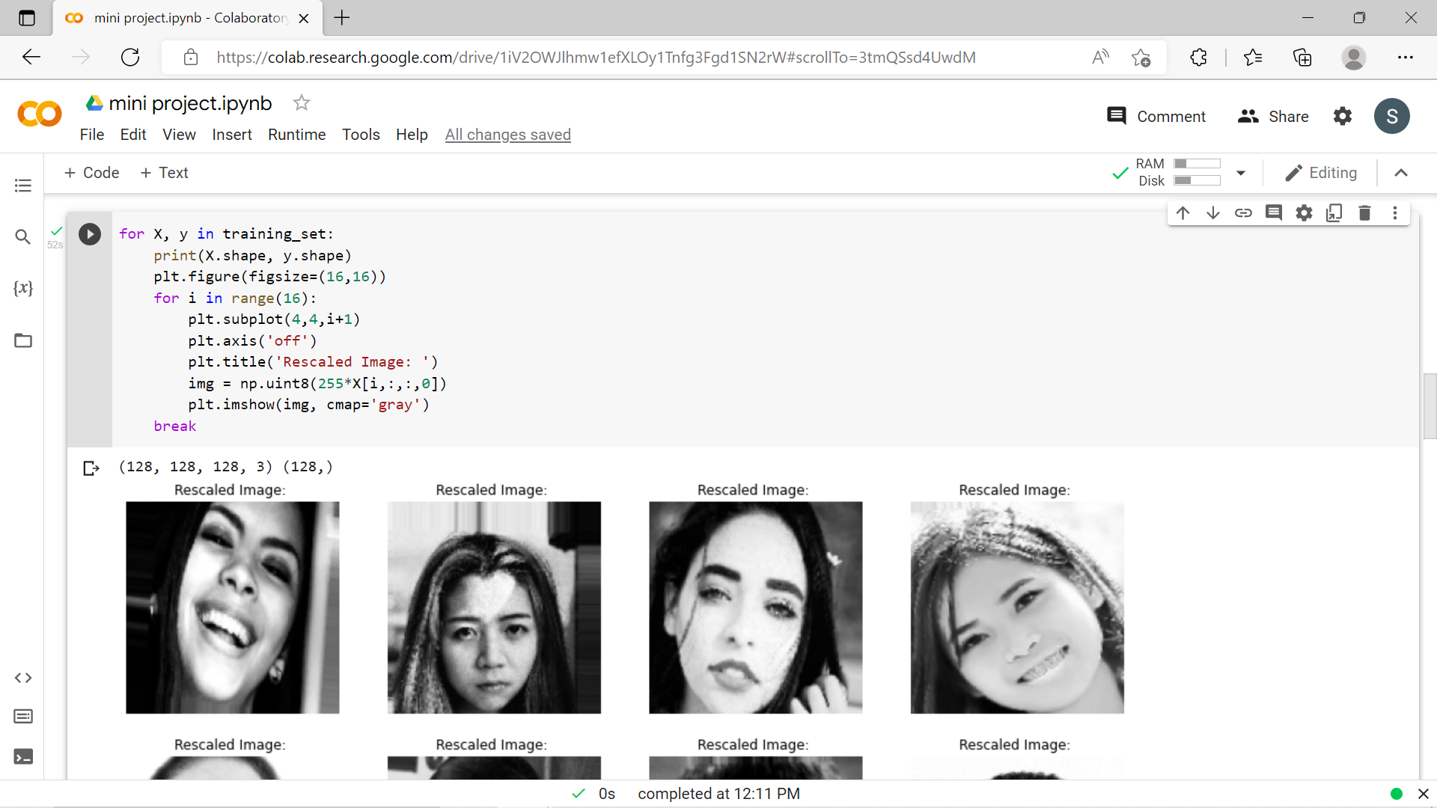
implementation
IMAGE PREPROCESING

Slide 23
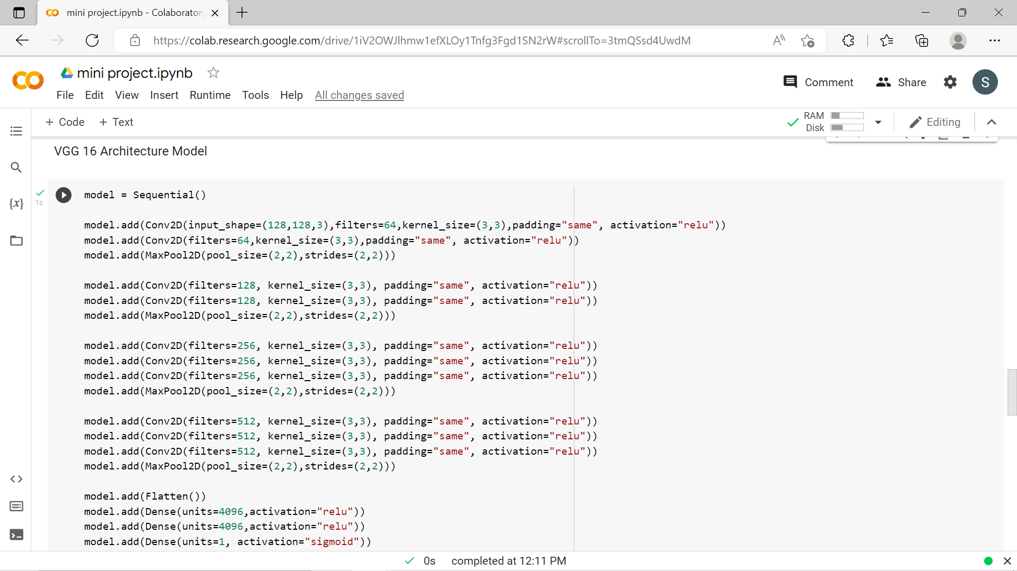
implementation
BUILDING MODEL

Slide 24
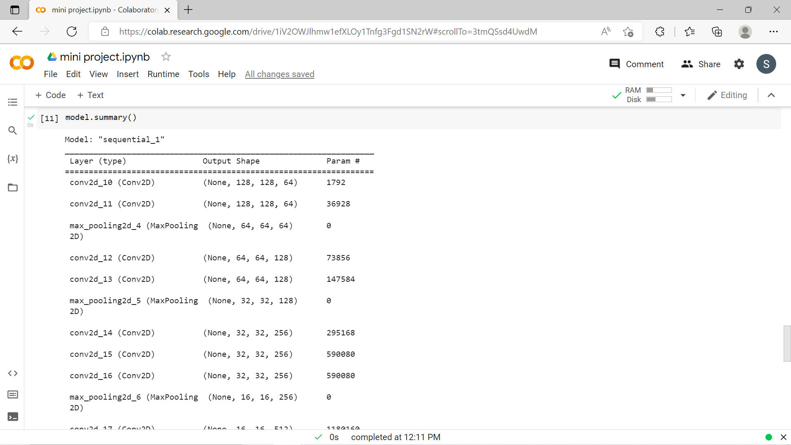
implementation
MODEL SUMMARY

Slide 25
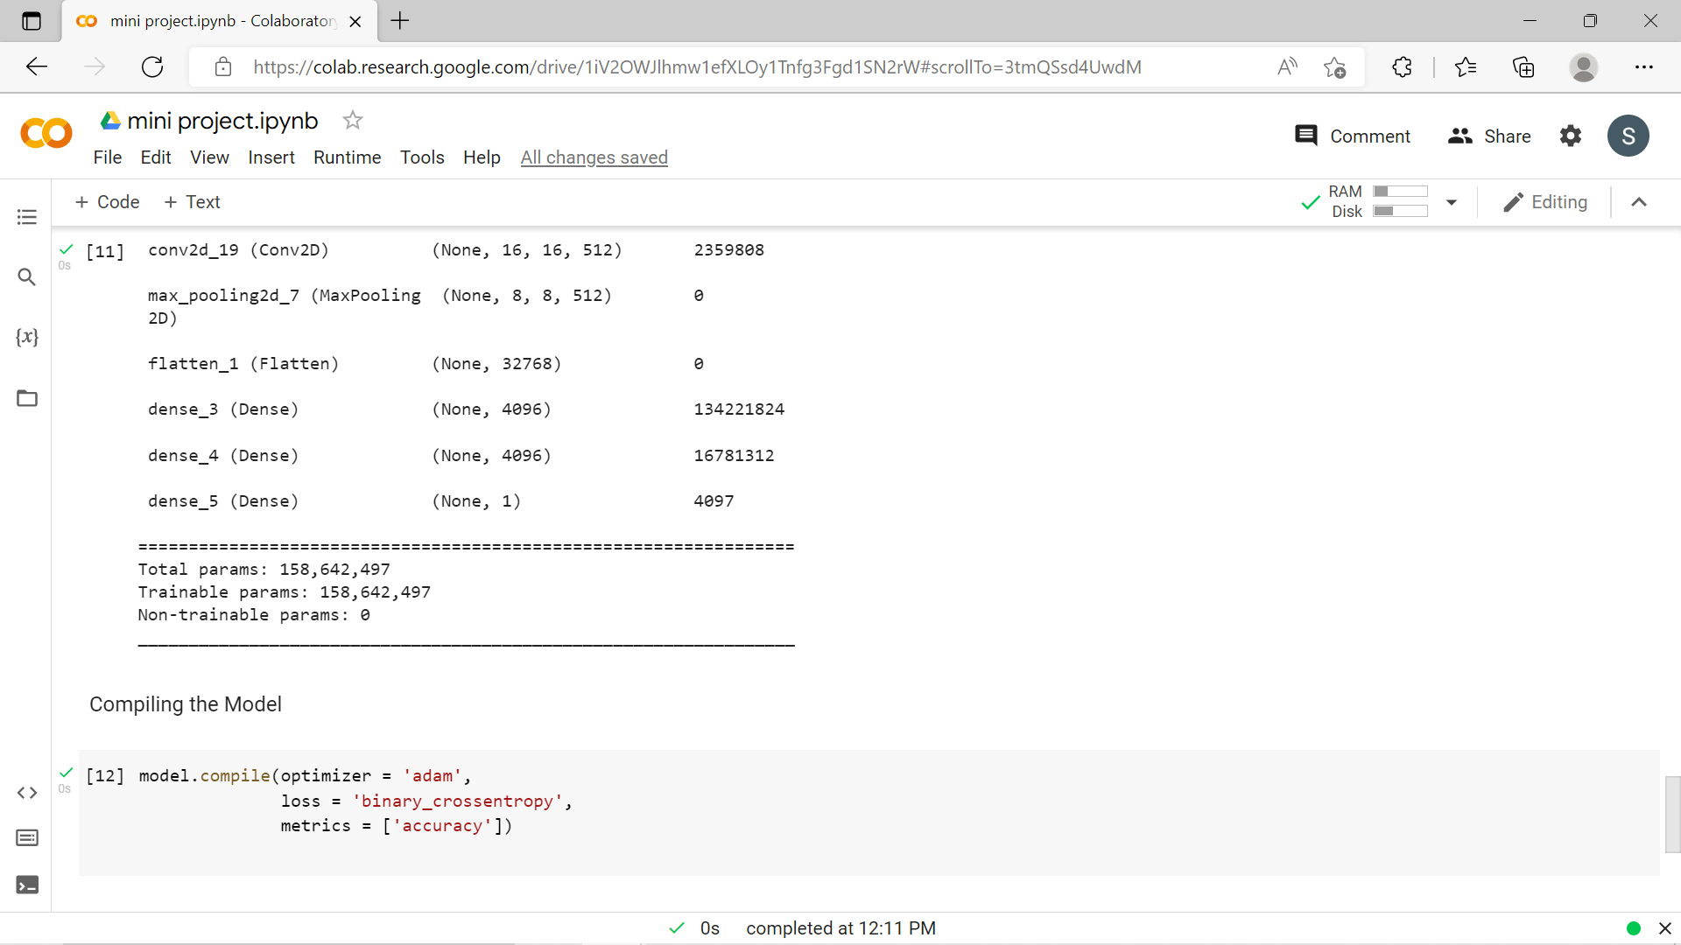
implementation
COMPILING MODEL

Slide 26
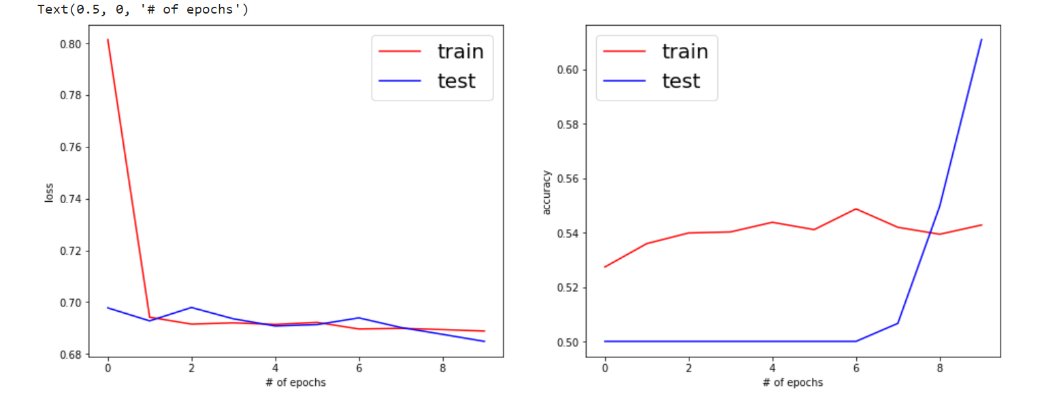
implementation
VALUE LOSS AND VALUE ACCURACY OF MODEL:

Slide 27
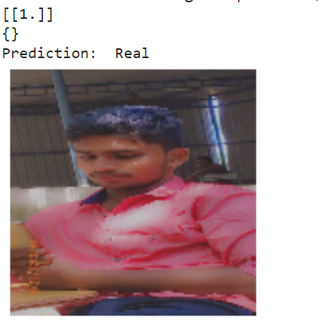
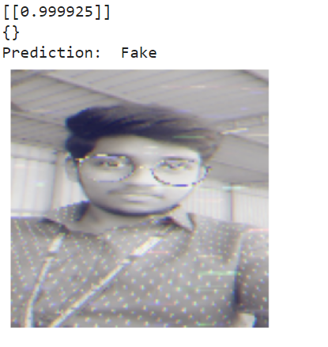
implementation
PREDICTIONS:
a)Real Image
b)Fake Image

Slide 28
SOCIAL IMPACTS
Comparing to previous models (ELA ,DL,Image tampering),Our proposed model will attain more Training Accuracy and Testing accuracy.
Using this model we can easily detect fake images and avoid them from wide spreading in social medias.
Fake evidences which misleads court can be detected

Slide 29
rEFERENCES
1) Sudiatmika, I. B. K., & Rahman, F. (2019). Image forgery detection
using error level analysis and deep learning. Telkomnika, 17(2), 653-
659.
2) Isaac, M. M., & Wilscy, M. (2015). Image forgery detection based on
Gabor wavelets and local phase quantization. Procedia Computer
Science, 58, 76-83.
3) Hakimi, F., Zanjan, I., & Hariri, I. (2015). Image-splicing forgery
detection based on improved lbp and k-nearest neighbors
algorithm. Electron Inf Plan, 3.
4) Dong, J., Wang, W., & Tan, T. (2013, July). Casia image tampering
detection evaluation database. In 2013 IEEE China Summit and
International Conference on Signal and Information Processing (pp.
422-426). IEEE..
5) Li, W., Yuan, Y., & Yu, N. (2009). Passive detection of doctored JPEG
image via block artifact grid extraction. Signal Processing, 89(9), 1821-
1829..

Slide 30
rEFERENCES
6) Villan, Muhammed Afsal, et al. "Fake Image Detection Using Machine
Learning." IRACST-International Journal of Computer Science and
Information Technology & Security (IJCSITS) (2017).
7) Hsu, Chih-Chung, Yi-Xiu Zhuang, and Chia-Yen Lee. "Deep fake image
detection based on pairwise learning." Applied Sciences 10.1 (2020): 370.
8) Akhtar, F., & Qayyum, H. (2018). Two Fold Image Forgery Detection
System Using Combined Key point based method and Block based
method. Journal of Information Communication Technologies and
Robotic Applications, 62-70.
9) Villan, M. A., Kuruvilla, A., Paul, J., & Elias, E. P. (2017). Fake Image
Detection Using Machine Learning. IRACST—International Journal of
Computer Science and Information Technology & Security (IJCSITS).
10) Sarma, B., & Nandi, G. (2014). A Study on Digital Image Forgery
Detection. International Journal of Advanced Research in Computer
Science and Software Engineering, 4(11).

Slide 31
rEFERENCES
11) Jeon, Hyeonseong, Youngoh Bang, and Simon S. Woo. "Facingoff fake images using fake detection fine-tuning network." IFIP InternationalConference on ICT Systems Security and Privacy Protection. Springer, Cham,2020.
12) Mahale, V. H., Ali, M. M., Yannawar, P. L., & Gaikwad, A. T. (2017).
Image inconsistency detection using local binary pattern
(LBP). Procedia computer science, 115, 501-508.
13) Hashmi, M. F., Anand, V., & Keskar, A. G. (2014). Copy-move image
forgery detection using an efficient and robust method combining undecimated
wavelet transform and scale invariant feature transform. Aasri
Procedia, 9, 84-91.
14) Hu, W. C., Chen, W. H., Huang, D. Y., & Yang, C. Y. (2016). Effective
image forgery detection of tampered foreground or background image
based on image watermarking and alpha mattes. Multimedia Tools and
Applications, 75(6), 3495-3516.
15) Tariq, Shahroz, et al. "Detecting both machine and human created fake
face images in the wild." Proceedings of the 2nd international workshop on
multimedia privacy and security. 2018.

Slide 32
THAnk you!

